Slide 1
Deep neural network

Slide 2
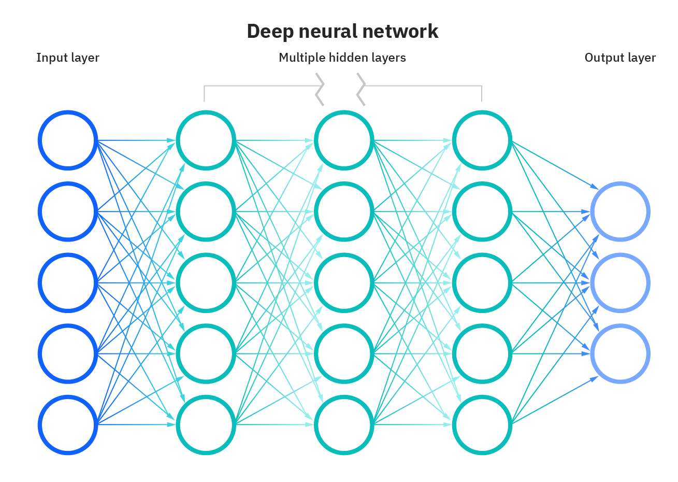






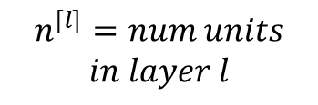
1. Neural network representation
Activation_fn1
Activation_fn3
$$L = num_layers = 4$$
Activation_fn2
Activation_fn4
$$n^{[l]}=num units$$
$$in layer l$$
$$Y≡A^{L}$$
$$X ≡ A^{0}$$
$$A^{1}$$
$$A^{2}$$
$$A^{3}$$

Slide 3
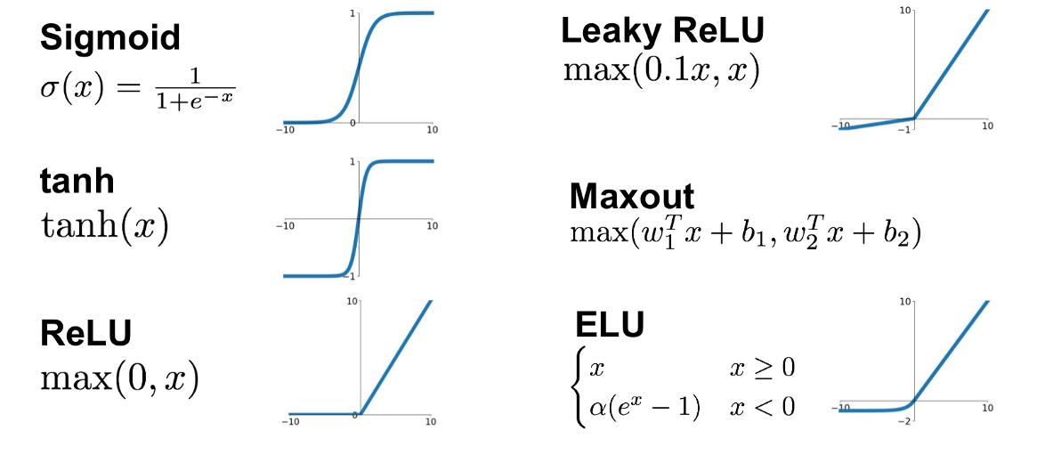
2. Activation function

Slide 4
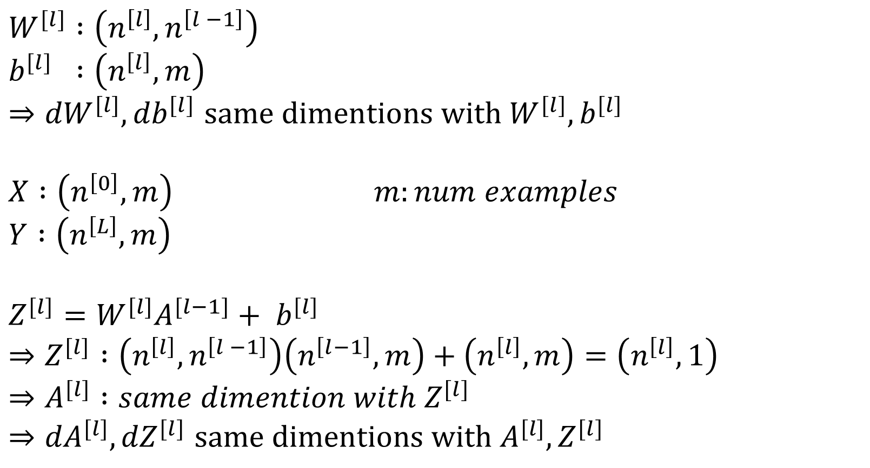
3. dimention
$$W^{[l]} :\left(n^{\left[l\right]}, n^{\left[l −1\right]}\right)$$
$$b^{[l]} :\left(n^{\left[l\right]}, m\right)$$
$⇒{dW}^{[l]}, {db}^{[l]}$ $same dimentions with W^{[l]}, b^{[l]}$
$$X :\left(n^{\left[0\right]}, m\right) m:num examples$$
$$Y :\left(n^{\left[L\right]}, m\right)$$
$$Z^{[l]}=W^{[l]}A^{[l−1]}+ b^{[l]}$$
$$⇒Z^{[l]} :\left(n^{\left[l\right]}, n^{\left[l −1\right]}\right)\left(n^{\left[l−1\right]}, m\right)+\left(n^{\left[l\right]}, m\right)=\left(n^{\left[l\right]}, 1\right)$$
$$⇒A^{[l]} :same dimention with Z^{[l]}$$
$⇒{dA}^{[l]}, {dZ}^{[l]}$ $same dimentions with A^{[l]}, Z^{[l]}$

Slide 5
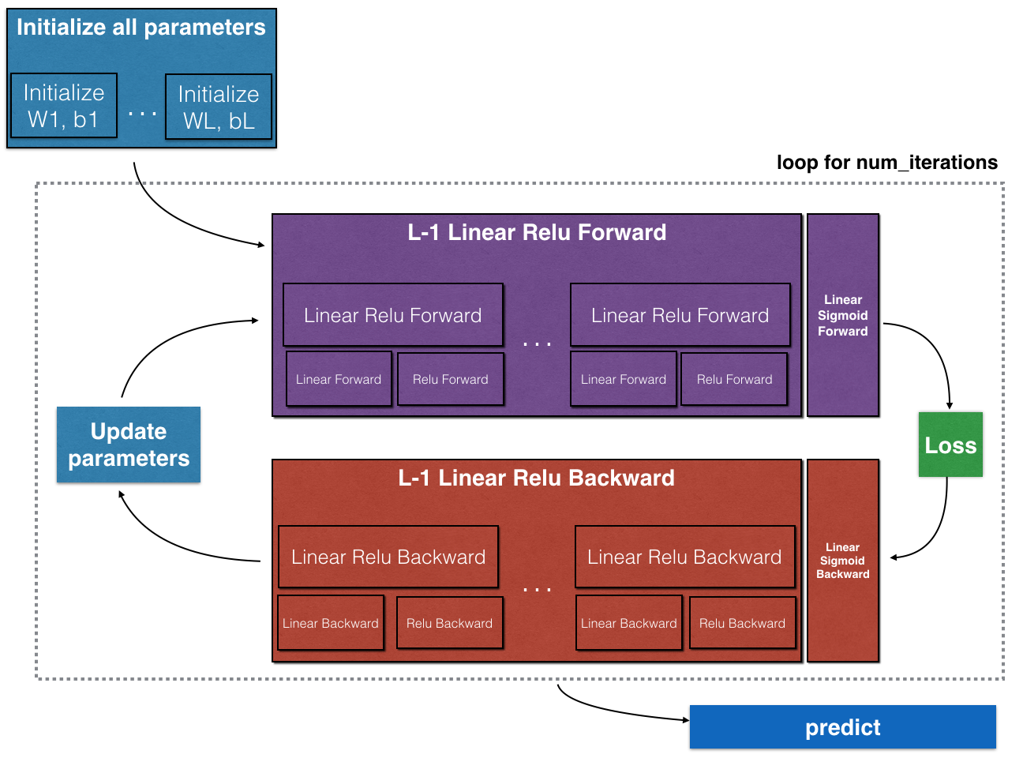
4. implementation

Slide 6
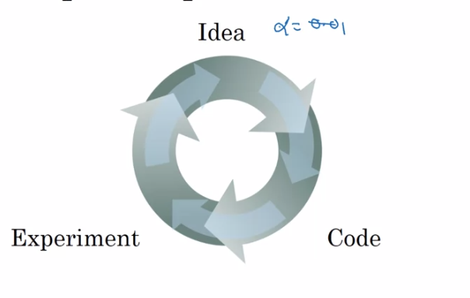
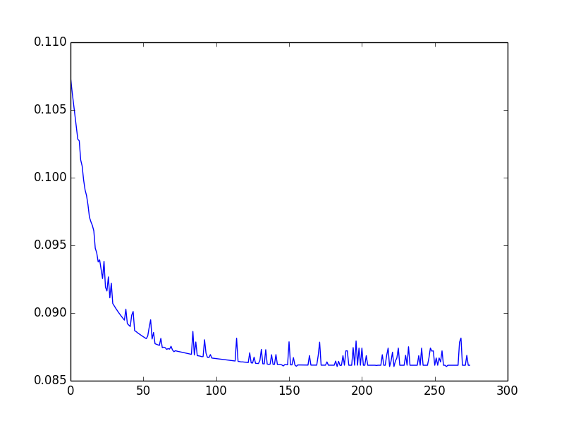
5. Optimization
Cost function after i(th)-iterater

